Slide 1
Rethinking Adverse Childhood Experiences
Dr. Gia Elise Barboza, Esq.
gbarboza@uccs.edu
New Conceptual, Methodological and Theoretical Approaches

Slide 2
Introduction/Overview
Adverse Child Experiences Study & Approach
Methodological & Conceptual Limitations of the ACEs Sum Score
Rethinking the ACE Sum Score
Issues of Measurement
Typologies
Interrelationships
Spatial Heterogeneity
Implications and Future Directions
Notes:
Today I will briefly mention the origins and importance of the ACEs – adverse child experiences study and importance.
Then, I will talk about the ways that ACEs have been used to assess behavioral health outcomes.
Next, I will cover some different methodological approaches that I have used in my own research that I would argue yield more intuitive and/or useful insights before proposing some implications of this work and future directions.

Slide 3
Background
Definition of ACEs
Research has yielded three major findings
Child adversity is a common occurrence
Individuals who experience one type of adversity typically experience another
Multiple compared to singular risks are developmentally damaging
Notes:
ACEs range from being physically, emotionally and/or sexually abused as a child to living in a household characterized by a caregiver who is mentally ill, has a substance use problem, has had CJ involvement, witnessing domestic violence in the household or growing up in a household where parents were divorced or separated.
Decades of research ha yielded three major findings:
Child adversity is a common occurrence;
Individuals who experience one type of adversity typically experience more than one; and
Multiple compared to singular risks are developmentally damaging and have adverse long term adult impacts

Slide 4
The Sum Score, “ACE” Score or Cumulative Risk Score (“CR”)
The co-occurring nature of ACEs has led to the use of an “ACE score,” which represents the total number of ACE categories designed to measure CR
The ACE score (i.e., CR approach) has vastly improved our knowledge about the pervasive and detrimental effects of multiple forms of early childhood adversity
Negative sequelae of cumulative ACE burden
Depression (Chapman, Dube, & Anda, 2007)
Alcohol abuse (Dube et al., 2001)
HIV risk-taking behavior (Bensley, Van Eenwyk, & Simmons, 2000)
Notes:
The co-occurring nature of ACEs has led to the use of an “ACE sum score,” which represents the total number of ACE categories designed to measure CR. The sum score is a measure of the total number of ACEs an individual has experienced and is a common way of measuring cumulative burden.
The ACE score (i.e., CR approach) has vastly improved our knowledge about the pervasive and detrimental effects of multiple forms of early childhood adversity
The importance of the cumulative nature of ACEs and its long term impact is well-recognized in the empirical literature including the literature on polyvictimization.
Researchers have concluded that accumulation of risks over the life span is an important etiologic pathway to persistent health problems such as depression, alcohol and drug use and abuse and sexual risk taking behaviors.

Slide 5
Methodological Limitations of the ACE Sum Score
Additivity
Multiplicity
Does 2 + 2 = 4 or 5?
Is 3 > 4 or 4 > 3?
Does marginal cost = 0?
Does “2” = “2”
Does the risk of 1 ACE depend on the risk of another?
Which of the 2^{x} permutations are children experiencing and in what ways does it matter in the long-term?
Notes:
Despite multiple advantages the sum score has methodological limitations. First, it assumes linearity whereby there is a ‘dose-response’ relationship between ACEs and health outcomes.
But, research has shown that accumulation is not always additive.
For example, individuals with ACE scores of 1, 2 and 3 compared to 0 have been demonstrated to have similar levels of depression and unemployment rates (Evans et al., 2013; Lui et al., 2013). Therefore 1 plus 1 doesn’t equal 2.
As well, individuals with a single risk factor profile (i.e., 1 ACE) have been shown to have a greater risk for low vocabulary intelligence compared to a profile characterized by physical abuse and neglect. In this case, 1 > 2.
Also unclear is whether the marginal cost of an additional ACE = 0? Instead, the effect of moving from 2 or 3 ACEs may exert a greater effect on a child than moving from 7 or 8
Research has also challenged the idea that risk is linear by suggesting that the presence of one risk depends on another, in other words risks are multiplicative.
Research has shown for example that maternal depression is related to the development of internalizing behavior among children particularly when experienced in combination with neglect
Most importantly, the sum score provides no information about heterogeneity of risk experiences – information about an individual’s unique life experiences or how individuals experience different constellations of risk is lost.

Slide 6
Other Limitations
What theoretical lens can be used to interpret ACEs?
To whom can the ACEs results be generalized to?
What is missing from the typical ACE scale?
What is the broader context of ACEs?
Notes:
Death of parent, death of friend, violence exposure, poverty indicators – many recent attempts to incorporate these into the traditional ACEs framework in some way. But, to my knowledge attempts to incorporate items specific to the experiences of historically marginalized populations has not been forthcoming. For example, among youth of color, experiences of racial discrimination have been repeatedly shown to be highly correlated with poor health outcomes across the lifespan.

Slide 7
Adverse Child Experiences and the Multiple Contexts of Child Development
Reciprocal interactions between developing child and her environment
Any one risk factor has limited explanatory power over the identification of ‘constellations of risk’
The processes undergirding CR are conditional on the pattern of interactions between the child and the broader environment in which he or she exists.
Principles of multi- and equ- finality
Notes:
Many studies of ACEs are atheoretical.
However, the conceptual framework of the CR approach is closely aligned to Bronfenbrenner’s socioecological model of human development which provides a way to theorize about the impact of ACEs and is directly linked to different methodologies aimed to measure broader impact.
Briefly, the socioecological perspective offers an approach that captures the heterogeneity of risk experiences and a way of thinking about the dependency between risk domains that makes the linkages between CR and long-term outcomes more explicit and modifiable. How?
First, in this framework, specific combinations of risk factors across multiple domains are more closely linked to poor psychosocial and behavioral problems
Second, any one risk factor, has limited explanatory value over the identification of constellations of risk
Third, this theoretical lens allows for nonlinear and higher order interactions between different constellations of multiple, interacting risk factors.
Finally, and importantly, principles of multifinality (i.e., similar risks may lead to different developmental outcomes), equifinality (i.e., different risks may lead to similar developmental outcomes), and resilience (i.e., high-risk individuals show highly adaptive long-term functioning) are incorporated as critical explanatory factors that explain different developmental processes.

Slide 8
New Methodological Approaches to ACEs
New approaches represent conceptual and methodological shifts away from the commonly used ACE sum score
Latent Class Analysis – Typologies of ACEs
Network Analysis – ACE interrelationships
Spatial Analysis – Spatial contexts of ACEs
Compatible with the vision of a socioecological perspective

Slide 9
The Data
Center for Disease Control’s (CDC) Behavioral Risk Factor Surveillance System Survey(“BRFSS”) https://www.cdc.gov/brfss/annual_data/annual_2019.html
Health Resources & Services Administration’s (HRSA) National Survey of Children’s Health https://www.census.gov/programs-surveys/nsch/data.html (“NSCH”)
San Francisco City Survey Data https://data.sfgov.org/City-Management-and-Ethics/San-Francisco-City-Survey-Data-1996-2017/huch-6k5m
Notes:
In what follows I have used data to demonstrate some alternative ways to use ACEs indicators for prevention. Briefly, I am using two surveys that are meant to be representative of the US population, the BRFSS and the NSCH. Both studies gauge health related risk behaviors with one key difference. The BRFSS is retrospective asking adults about their experiences as children, whereas the NSCH focuses on the health of children between 0-17 as reported by their primary caregivers. The third study is from the city of San Francisco open data portal and is useful because respondents reported on various aspects of their living arrangements that can be linked to the spatial context in which they live.
Here are the descriptions from their websites.
The Behavioral Risk Factor Surveillance System (BRFSS) is the nation’s premier system of health-related telephone surveys that collect state data about U.S. residents regarding their health-related risk behaviors, chronic health conditions, and use of preventive services. Established in 1984 with 15 states, BRFSS now collects data in all 50 states as well as the District of Columbia and three U.S. territories. BRFSS completes more than 400,000 adult interviews each year, making it the largest continuously conducted health survey system in the world.
The NSCH examines the physical and emotional health of children ages 0-17 years of age. Special emphasis is placed on factors related to the well-being of children. These factors include access to - and quality of - health care, family interactions, parental health, neighborhood characteristics, as well as school and after-school experiences.
A phone survey conducted by the city of SF to objectively assesses San Francisco residents’ use of and satisfaction with various city services.

Slide 10
Rethinking ACEs 1: Typologies of Adversity Using Latent Class Analysis (”LCA”)
LCA
Identifies homogenous population subgroups with similar constellations of ACE risk rather than relying on a priori cut points of CR
Allows for the interpretation of nonadditive and higher order interactions among risk factors,
Does not treat risk factors as interchangeable, and
Provides new insights into the multiplicative effects of risks at different ecological levels

Slide 11
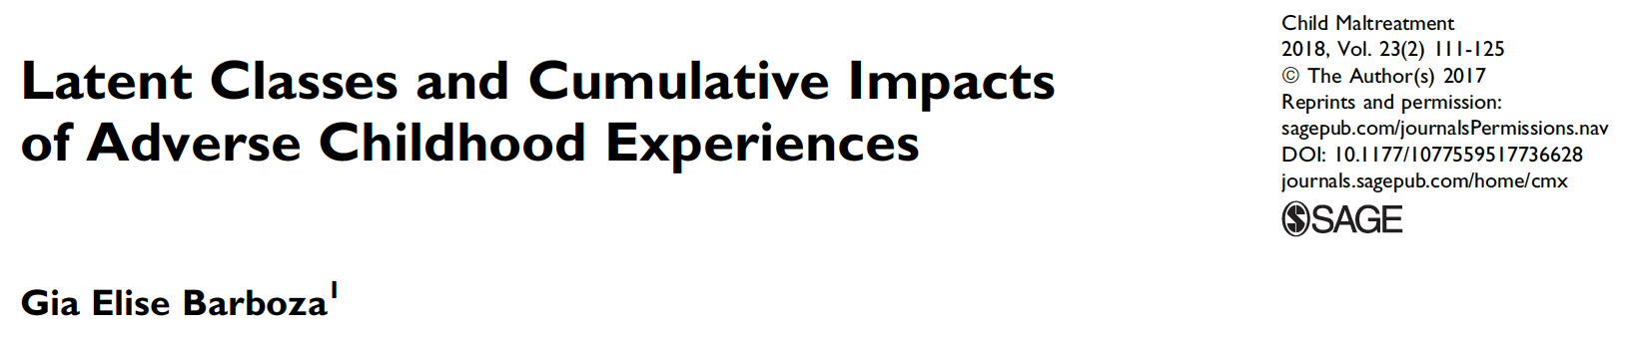
RESEARCH GOALS
How do the ACEs group together and how many groups can be identified?
Are there differences in CR across groupings of ACEs?
Do the groups differentially predict behavioral and mental health outcomes in adulthood?

Slide 12
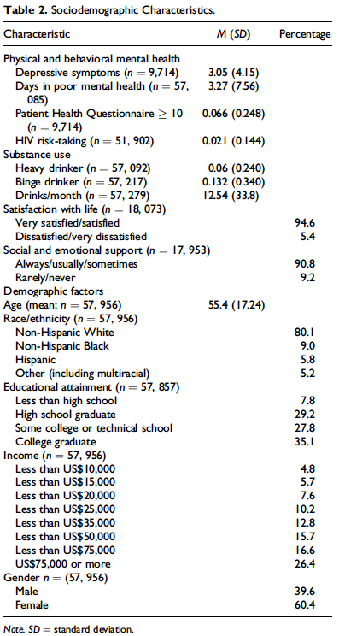
Sample Characteristics of the BRFSS
The sample is predominantly white, highly educated, wealthy and majority female
Notes:
Here are the characteristics of the BRFSS.
Respondents endorsed an average of 3 out of 10 depressive symptoms
about 6.6% had probable MDD and about 2% reported engaging in sexual risk behaviors
13% were identified as binge drinkers.
Respondents were 55.4 years old, tended to be satisfied with their lives, have high levels of emotional and social support and predominantly white, highly educated, wealthy and majority female.
The representativeness of this sample is obviously limited by these characteristics a point to which I will return later.

Slide 13
ACES
BRFSS Adverse Childhood Experience (ACE) Module All questions refer to the time period before you were 18 years of age.
Question Wording | n (%) | Response | Coding
Did you live with anyone who
1. was depressed, mentally ill, or suicidal? | 57,437 (15.7) | 1=Yes 2=No 7=DK/NS 9=Refused | 0 = No 1 = Yes 7, 9 = missing
2. was a problem drinker or alcoholic? | 57,646 (23.6)
3. abused prescription medications? | 57,665 (7.7)
4. served time or was sentenced to serve time in a prison, jail, or other correctional facility? | 57,788 (4.9)
5. Were your parents never married, separated or divorced? | 57,219 (21.0) | 1=Yes 2=No 8=Parents not married 7=DK/NS 9=Refused | 1 = divorced, separated, never married 0 = not divorced, separated or married
How often did your parents or adults in your home ever: |  | 1=Never 2=Once 3=More than once 7=DK/NS 9=Refused | 0 = never 1 = one or more times
6. slap, hit, kick, punch or beat each other up? | 57,019 (14.9)
7. hit, beat, kick, or physically hurt you in any way? Do not include spanking | 57,468 (15.3)
8. swore at you, insulted you, or put you down? | 57,103 (31.5)
How often did anyone at least 5 years older than you or an
9. adult, ever touch you sexually? | 57,272 (10.3)
10. try to make you touch them sexually? | 57,320 (7.1)
11. force you to have sex? | 57,329 (4.0)
Notes:
This table shows the number and percentages of people endorsing the 11 ACEs in the survey.
Emotional abuse was the most common experience followed by living with a problem drinker or alcoholic.
The least commonly reported ACEs were being forced to have sex and living with someone who had criminal justice involvement.

Slide 14
Multiple Exposure and Cumulative Impact
ACE Category | NONE | ≥1 | ≥2 | ≥3 | ≥4 | ≥5
Abuse
Emotional | 25 | 75 | 53 | 36 | 22 | 14
Physical | 9 | 91 | 75 | 58 | 41 | 27
Sexual Touching (Youth to adult) | 11 | 89 | 71 | 55 | 40 | 29
Sexual Touching (Adult to youth) | 4 | 96 | 80 | 63 | 48 | 37
Forced Intercourse | 3 | 97 | 92 | 78 | 65 | 50
Household Dysfunction
Parental Divorce/Separation | 29 | 71 | 53 | 38 | 26 | 17
Alcohol Abuse | 28 | 72 | 49 | 33 | 21 | 13
Drug Abuse | 9 | 91 | 75 | 57 | 42 | 30
Mental illness | 20 | 80 | 59 | 41 | 28 | 18
Domestic Violence | 10 | 90 | 73 | 55 | 38 | 25
Parental Incarceration | 13 | 87 | 74 | 59 | 46 | 30
Notes:
This chart shows the conditional and cumulative distribution of ACEs.
The first column is the percentage of persons reporting that did not experience and additional ACE given that they experienced the ACE reported in that row.
The other columns show the percentage experiencing at least one additional ACEs, given that they experienced the one reported in the row.
So for example, in red, about 25% of the sample experienced emotional abuse only; in addition to experiencing emotional abuse, however, 75% experienced at least one additional ACE, 53% experienced two or more and 14% experienced 5 or more.
In green, individuals who experienced forced intercourse were more likely to experience an additional ACE.
This is despite the fact that forced intercourse was the least likely to be reported by respondents overall.

Slide 15
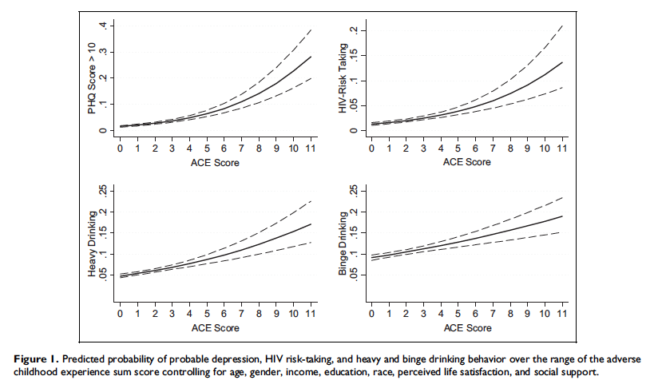
Notes:
This plot shows the sum score on the x-axis and different outcomes on the y-axis including PHQ score which is a measure of depressive symptoms, HIV risk taking behavior such as sharing needles and not wearing a condom, and problem drinking.
In all cases, as ACE score increases, the probability of endorsing these negative behaviors increases as well.
For example, the probability of a PHQ score greater than 10 (clinically relevant depression) is around .3 for respondents with 11 ACEs.
In contrast, individuals with no ACEs have a 0 probability of a PHQ score greater than 10.

Slide 16
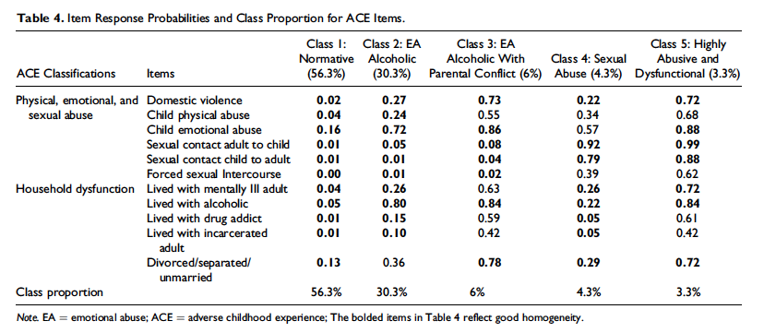
Notes:
The results of the latent class analysis are presented here.
You notice that the majority of respondents (56.3%) had low probability of endorsing any of the 11 ACEs.
This class is the normative class.
On the other end of the spectrum lies the persons who endorsed all of the ACEs with high probability, which is class 5, the class of respondents who lived in highly abusive and dysfunctional households.
The other types of household living arrangements that emerged from the analysis are
children living in emotionally abusive alcoholic households (class 2)
children living in emotionally abusive alcoholic households with parental conflict (class 3)
and children who were sexually abused but did not experience any of the other ACEs (class 4)

Slide 17
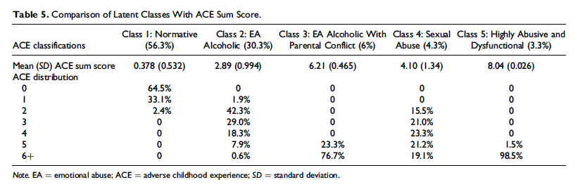
The takeaway here is that individuals in each class have different distributions of sum scores and within each of the types of household the number of ACEs that people experience is quite variable. Youth with a sum score of 5 for example, are equally likely to be in class 3 or class 4 but have not had nearly the same experiences growing up.
Notes:
Here we have the Latent Classes compared to the ACE sum score.
Focusing on the first row, we see that the 56.3% of youth in the low adversity, or normative class, have less than 1 ACE on average.
The 30.3% of youth living in the emotionally abusive alcoholic class have about 2.89 ACEs on average, etc.
The chart also shows the ACE distribution for each class.
Focusing on the columns we see that 64.5% of youth in the normative class have no ACEs whereas 33.1% have 1 and 2.4% have 2.
None of the youth in the low adversity class have 3 or more ACEs.
The takeaway here is that individuals in each class have different distributions of sum scores and within each of the types of household the number of ACEs that people experience is quite variable. Youth with a sum score of 5 for example, are equally likely to be in class 3 or class 4, but have not had nearly the same experiences growing up.

Slide 18
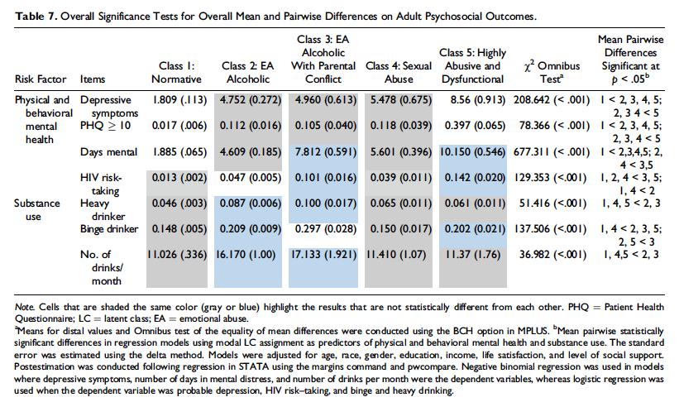
Notes:
This slide shows differences in psychosocial outcomes across classes. Looking across the row if the cell is shaded the same color there is no statistically significant difference in the outcome, but if the cell is a different color the result is statistically significant.
You recall that in each case the sum score predicted depression, HIV-risk taking and drinking behaviors. However, what this slide shows is that not all classes predict these outcomes in the same way. To highlight just one example, consider binge drinking.
Youth growing up in emotionally abusive alcoholic households with parental conflict have the highest probability of engaging in binge drinking behavior (.297). This is statistically higher than any other class. Whereas youth in the emotionally abusive and alcoholic classes are more likely to engage in binge drinking compared to youth with little to no adversity, there is no difference in drinking prevalence between these groups.
The takeaway is that the types of ACEs that characterize youth households matter for their long term outcomes in adulthood but the ACE sum score does not capture these differences.

Slide 19
Rethinking Indicators

Slide 20
Capturing the Complexity of the ACE Construct
Research has shown
Child neglect is associated with externalizing outcomes in children (Manly, Oshri, Herzong & Wortel, 2013) → basic needs
The death of the father during childhood more than doubles the risk for major depressive disorder in adulthood (Jacobs & Bovasso, 2009)
The original ACEs list should be expanded to include poverty and neighborhood safety
Poor mental health outcomes are associated with weak racial and ethnic identity among multiracial adolescents (Fisher, Reynolds, Hsu, Barnes et al. 2014)
The conceptual definition needs expansion
Notes:
The current ACEs measures capture a lot of types of child adversity, however the measure needs to be expanded

Slide 21
Notes:
This is another LCA using the additional ACE measures.
First, the orange represents the probability of endorsing the ACE on the bottom given membership in each class shown along the column.
I want to focus on two groups.
First, the first row is the group of children experiencing very high levels of adversity including neighborhood violence, living in families who are unable to meet basic needs and experiencing racial discrimination.
Second, there is a class of youth who are very unlikely to experience any adversity, i.e. the normative or low adversity class.

Slide 22
 | Odds Ratio Low v High Adversity Class
Age | 0.9023
Low adversity class
High adversity class
Notes:
The odds of being in the low adversity class versus the high adversity class decrease with age. As children age, they are likely to experience more adversity.

Slide 23
ACE Classes by Key Mental Health Problems
The ACE sum score is significantly related to depression, anxiety and conduct disorder
The odds of endorsing lifetime depression, anxiety and conduct disorder are between 1.4 and 1.6 times higher with each additional ACE
Notes:
In all cases, the ACE sum score is significantly related to depression, anxiety and conduct disorder
The odds of endorsing lifetime depression, anxiety and conduct disorder are between 1.4 and 1.6 times higher with each additional ACE

Slide 24
Ave. Sum Score | 0.3 | 2.3 | 2.7 | 2.9 | 5.6
Notes:
However as shown before the outcomes are significantly different by class. As before, children in the very low or very high adversity classes can be distinguished on outcomes however it is much harder to distinguish outcomes for the other three classes.

Slide 25
Multilevel & Multigroup LCA
Multilevel by neighborhood characteristics
Multigroup by race/ethnicity
Low Adversity
Low Adversity
Low Adversity
Low Adversity
Low Adversity
One Level 2 latent class is comprised of neighborhoods with a relatively large share of children who are in the low adversity class (i.e., 73% of the youth are adversity free compared to 43% of youth in non-supportive neighborhoods).
White youth are 2 and 1.7 times as likely to be in the low adversity class – that is those experiencing few to no ACES - class compared to black and LatinX youth, respectively
Notes:
In multiple-group LCA, we are interested in testing for measurement invariance. In this case, I am focusing on whether the underlying structure of ACEs is different across race/ethnicity.
More specifically, the multigroup analysis allows us to see if the proportion of youth in each class is similar across racial and ethnic groups– they are not:
The results show, for example, that White youth are more 2 times and 1.7 times as likely to be in the low adversity – that is those experiencing few to no ACES -- class compared to black and LatinX youth, respectively
Multilevel LC accounts for the hierarchical or nested structure in the data and allows the latent classes to vary across the higher order units or levels. Here I allow the classes to vary across two levels of neighborhood adversity, namely lack of social supports.
The results show that one Level 2 latent class is comprised of neighborhoods with a relatively large share of children who are in the low adversity class (i.e., 73% of the youth are adversity free compared to 43% of youth in non-supportive neighborhoods).
Youth living in supportive neighborhoods are 1.7 times more likely to be in the low adversity class

Slide 26
Rethinking ACEs 2: Networks of Adversity
Network science is the study of “patterns of interconnections” in a wide range of physical and social phenomena
Network psychometricians have developed novel ways to apply network theory to psychological indicators
Benefits and disadvantages

Slide 27
The Value of Network Analysis
The value of a psychological network is its ability to elucidate the underlying structural relationships between psychological indicators
Network psychometrics can provide answers to the following questions:
Do connections between subgroups exist?
What ACE indicators connect otherwise unconnected groups?
How might characteristics spread through a network?
How do the overall structures of a social network change after a particular event (e.g., someone gets remarried or stops drinking)?

Slide 28
Results: Network Analysis of ACEs
Notes:
Here are the results of a network analysis for the dichotomous presence/absence of ACE indicators.
Most, but not all items were positively associated with each other, indicating that ACE exposures are highly interrelated.
In other words, exposure to one type is associated with an increased risk of exposure to other types.
Interestingly, however, ACE1, living in working poor families, is negatively associated with living with someone who has a mental illness or who is addicted to substances.
The least connected variables are experiencing the death of parent, racial discrimination, living in a working poor family and living in a family that had difficulty meeting its basic needs.
The most connected variables are parental divorce/separation, incarceration, domestic violence, neighborhood violence and mental illness.
The figure on the right shows the results of a clustering algorithm applied to the network.
These categories are similar to the results of the LCA and cluster youth into poor families, families characterized by loss and families suffering from violence exposure and its causes and consequences.

Slide 29
Notes:
Here I present the results of several network metrics. Node strength and expected influence measure how strongly a node is directly connected. Here ACE 9 (substance use/abuse) ACE 3 (divorce/separation) and ACE 5 (parental incarceration) are the strongest nodes. Closeness measures how strongly a node is indirectly connected to other nodes. Parental Substance use as well as ACE 6 (Domestic Violence) are the closest nodes. Finally, betweenness measures how well one node connects to other nodes. Domestic violence and substance use are the nodes that connect the other nodes to each other.
It is interesting to note that the node corresponding to ACE 1 or working poor families to the weakest node in the network across all measures.

Slide 30
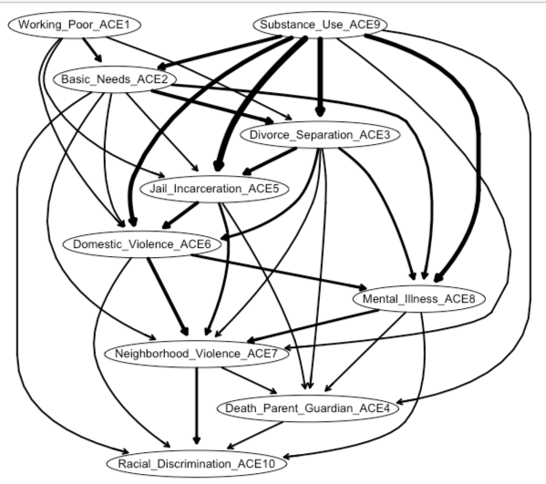
Directed Acyclic Graphs (DAGs)
The network graphs give no indication of ”potentially causal mechanisms”
The edge thickness represents the confidence that the direction of prediction is as presented in the graph
Substance use figures most prominently and directly predicts inability to meet basic needs, mental illness, divorce/separation, jail/incarceration, domestic violence and death of a parent/guardian
Notes:
These findings suggest that treating substance abuse is the key to minimizing ACEs burden in children.

Slide 31
Rethinking ACEs 3: Spatial Distributions
Traditional research focuses on ACEs as they affect children
Structural disadvantage can impact children and have similar properties
That is, we can construct a neighborhood level measure of ACEs and explore the spatial concentrations
Neighborhood Indicators
Poverty and housing and food insecurity
Violence exposure (child abuse, domestic violence, murder)
Unemployment and uninsurance
Incarceration rates
Drug and alcohol abuse/overdoses
Notes:
A large body of research shows that child outcomes are clustered in densely populated urban areas.

Slide 32
Considering the Spatial Distribution of ACEs
Item | High Adversity | Low Adversity | Moderate Adversity
Public Health Insurance | .70 | .09 | .20
Lives in Public Housing | .23 | .09 | .02
Moved three or more times in the past five years | .12 | .09 | .02
Poverty (Lives <= 200% below poverty line) | .67 | .01 | .08
Living with someone with a long-term physical, mental or emotional disability | .12 | .09 | .01
Living with someone incarcerated or in the adult or juvenile justice system | .01 | .03 | .02
Lives in overcrowded housing (>=1.5 persons/room) | .64 | .10 | .01
Lives in an Unsafe Neighborhood | .35 | .18 | .21
Lives in a family that is food insecure | .82 | .00 | .01
Lives in a family that lacks secure housing | .28 | .05 | .25
There is a playground, park or other natural outdoor space within walking distance of my home | .66 | .91 | .65
There is a market where I can buy fresh produce within walking distance of my home. | .62 | .88 | .30
Notes:
Note the advent of big open data makes a lot more possible

Slide 33
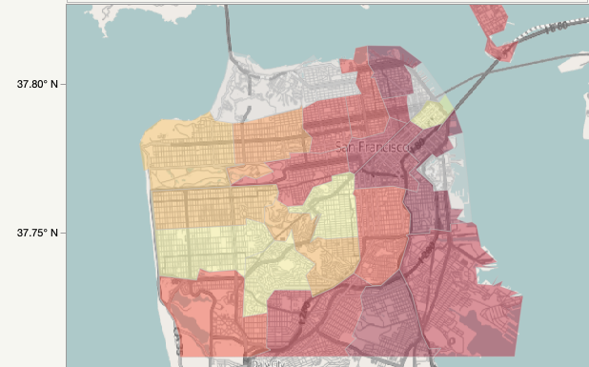
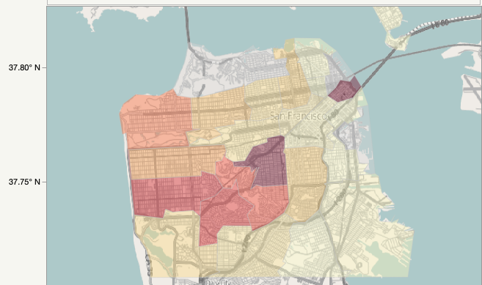
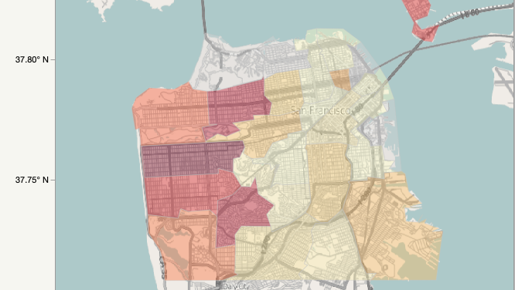
ACEs by Zip Code
The dark red areas are those with a high probability of being in that cluster (low, medium, high adversity)
Children living in areas corresponding to the highest levels of adversity are living in the eastern and southern parts of the city of San Francisco
Cluster 1:
High Adversity
Cluster 2:
Low Adversity
Cluster 3:
Moderate Adversity
Notes:
A number of recent studies have identified that certain combinations of adverse child experiences (ACEs) are differentially associated with a broad range of individual and/or community-level characteristics. Much less work has investigated the spatial heterogeneity and/or the community-level risk factors that are associated with distinct combinations of ACEs across urban spaces. The current study utilizes a Latent Class Analysis (LCA) to explore ACE typologies of families with children under the age of 18 in the city of San Francisco, California by situating them in their spatial context. Mean LC response probabilities were merged with a boundary file of San Francisco zip codes and merged with contextual data downloaded from several sources.

Slide 34

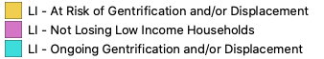
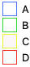
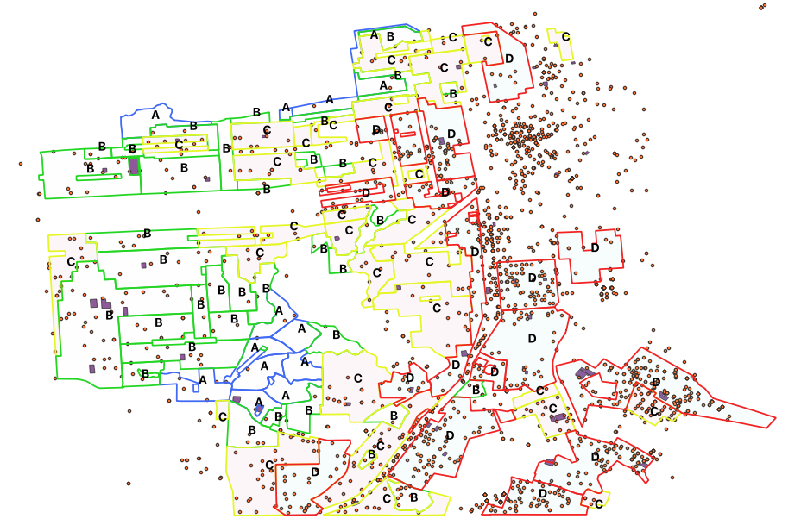
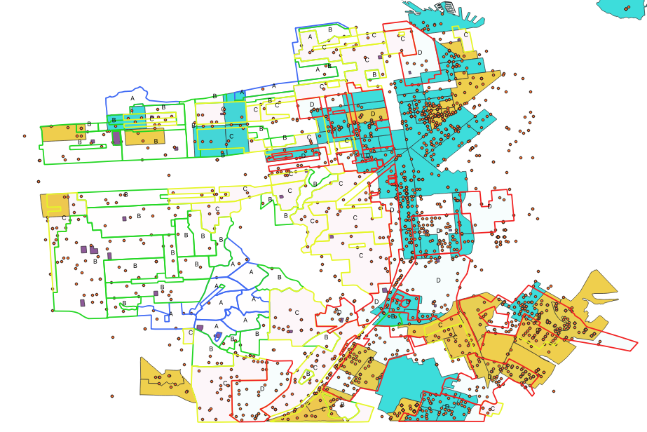
Linking Spatial Contexts: Community ACES
The community ACEs can be further linked to other spatial contexts such as gentrification and violence

Slide 35
Implications/Directions
Implications
Broaden ACEs to cover more indicators applicable to communities of color and historically marginalized populations
Importance of considering typology of ACEs, what predicts membership in ACEs classes, and which classes are differentially associated with long term risk factors
Explore interrelationships and which ACEs are most central, i.e. drive the system and are potentially causal
Situate individual ACEs in contexts of ACEs
Future Directions
Components of ACEs that are not captured in current definitions
Include measures tapping severity and frequency of ACEs
Explore differences across developmental statuses
Notes:
Future directions
--Even indexes that are expansive still omit key experiences regarding racial/ethnic identification including but not limited to immigration experiences and police interactions

Slide 36
References
Afifi, T. O., Salmon, S., Garcés, I., Struck, S., Fortier, J., Taillieu, T., ... & MacMillan, H. L. (2020). Confirmatory factor analysis of adverse childhood experiences (ACEs) among a community-based sample of parents and adolescents. BMC pediatrics, 20, 1-14.
Barboza, G. E. (2018). Latent classes and cumulative impacts of adverse childhood experiences. Child maltreatment, 23(2), 111-125.
Bensley, L. S., Van Eenwyk, J., & Simmons, K. W. (2000). Self-reported childhood sexual and physical abuse and adult HIV-risk behaviors and heavy drinking. American Journal of Preventive Medicine, 18, 151–158.
Chapman, D. P., Whitfield, C. L., Felitti, V. J., Dube, S. R., Edwards, V. J., & Anda, R. F. (2004). Adverse childhood experiences and the risk of depressive disorders in adulthood. Journal of Affective Disorders, 82, 217–225.
Dube, S. R., Anda, R. F., Felitti, V. J., Croft, J. B., Edwards, V. J., & Giles, W. H. (2001). Growing up with parental alcohol abuse: Exposure to childhood abuse, neglect, and household dysfunction. Child Abuse & Neglect, 25, 1627–1640.
Jacobs, J. R., & Bovasso, G. B. (2009). Re-examining the long-term effects of experiencing parental death in childhood on adult psychopathology. The Journal of nervous and mental disease, 197(1), 24-27.
Manly, J. T., Oshri, A., Lynch, M., Herzog, M., & Wortel, S. (2013). Child neglect and the development of externalizing behavior problems: Associations with maternal drug dependence and neighborhood crime. Child maltreatment, 18(1), 17-29.
Fisher, S., Reynolds, J. L., Hsu, W. W., Barnes, J., & Tyler, K. (2014). Examining multiracial youth in context: Ethnic identity development and mental health outcomes. Journal of youth and adolescence, 43(10), 1688-1699.

